Slide 1

FAST
الذی علم بالقلم۔ علم الانسان ما لم يعلم۔
National University of Computer and Emerging Sciences
DEPARMENT OF COMPUTER SCIENCE
Digital Logic Design
Notes:
The Foundation for Advancement of Science and Technology
The sponsoring body of the University – the Foundation for Advancement of Science and Technology (FAST) was established in 1980.
Start with the Name of Allah, Who is the most merciful and the most beneficent.

Slide 2
Digital logic design (lab-11) Latches
Notes:
Lets Start…!!!!

Slide 3
Latches
A Latch is a special type of logical circuit. The latches have low and high two stable states. Due to these states, latches also refer to as bistable-multivibrators.
A latch is a storage device that holds the data using the feedback lane.

Slide 4
Types of Latches
There are various types of latches used in digital circuits which are as follows:
SR Latch
Gated S-R Latch
D latch
Gated D Latch

Slide 5
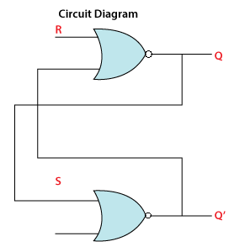
Sr Latch
SR Latch is a circuit with:
(i) 2 cross-coupled NOR gate or 2 cross-coupled NAND gate.
(ii) 2 input S for SET and R for RESET.
(iii) 2 output Q, Q’.
SR Latch is also called as Set Reset Latch.

Slide 6
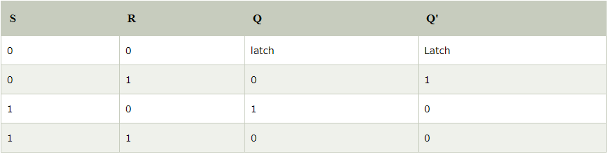
Sr Latch truth table
When both S and R are equal to 1, Q = 0 and Q’ = 0 which contradicts the complementary condition. Hence the input condition S = R = 1 is said to be not allowed.

Slide 7
Gated SR latch
A Gated SR Latch is a special type of SR Latch having three inputs, i.e., Set, Reset, and Enable. The enable input must be active for the SET and RESET inputs to be effective. The ENABLE input of gated SR Latch enables the operation of the SET and RESET inputs. This ENABLE input connects with a switch. The Set-Reset inputs are enabled when this switch is on. Otherwise, all the changes are ignored in the set and reset inputs. Below are the circuit diagram and the truth table of the Gated SR latch.

Slide 8
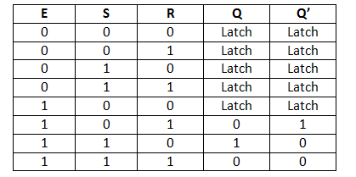
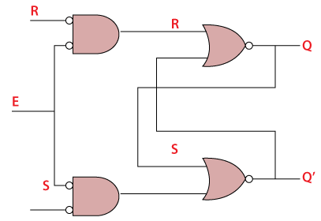
Gated SR latch contd..

Slide 9
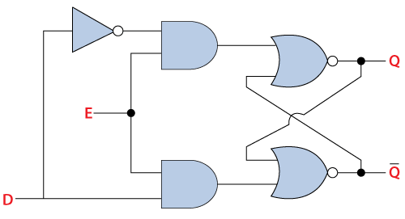
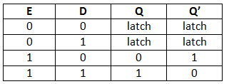
D latch
There is one drawback of SR Latch. That is the next state value can’t be predicted when both the inputs S & R are one.
So, we can overcome this difficulty by D Latch. It is also called as Data Latch. The circuit diagram of D Latch is shown in the following figure.

Slide 10
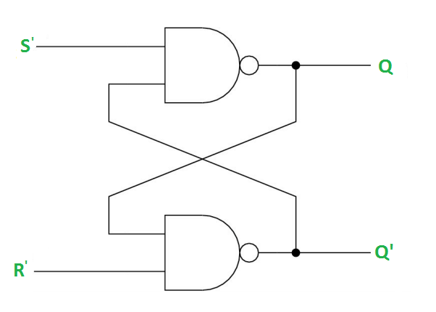
SR latch using nand version

Slide 11
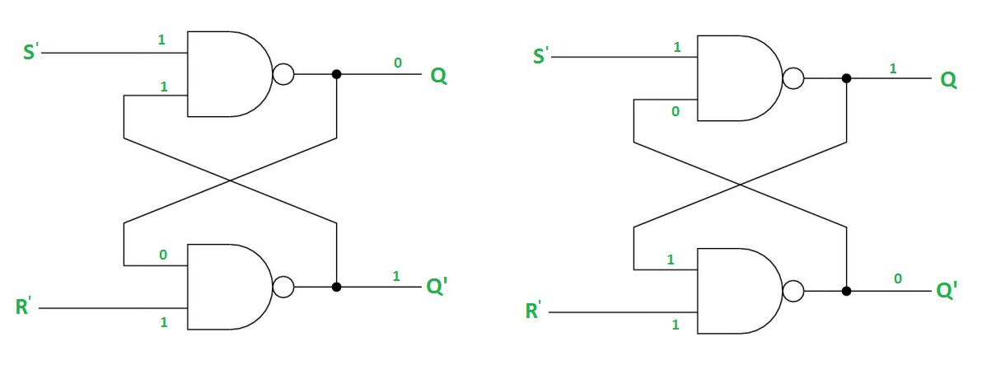
SR latch using nand contd..
Case-1: S’=R’=1

Slide 12
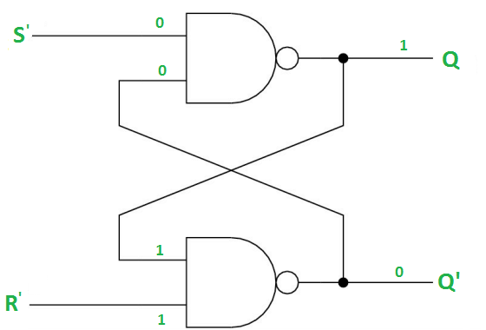
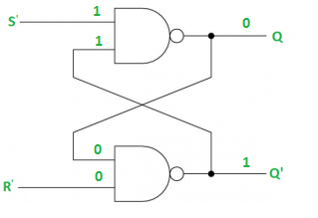
SR latch using nand contd..
Case-2: S’=0, R’=1
Case-3: S’= 1, R’= 0

Slide 13
SR latch using nand contd..
Case-4: S’= R’= 0
When S=R=1, both Q and Q’ becomes 1 which is not allowed. So, the input condition is prohibited.

Slide 14
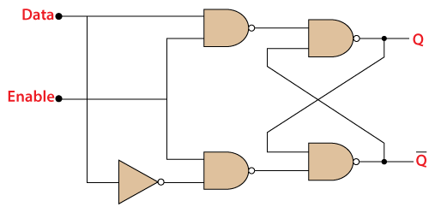
Gated D latch
The Gated D Latch is another special type of gated latch having two inputs, i.e., DATA and ENABLE. When the enable input set to 1, the input is the same as the Data input. Otherwise, there is no change in output.
We can design the gated D latch by using gated SR latch. The set and reset inputs are connected together using an inverter. By doing this, the outputs will be opposite to each other. Below is the circuit diagram of the Gated D latch.

Slide 15
Applications
Latches are single bit storage elements which are widely used in computing as well as data storage.
Latches are used in the circuits like power gating & clock as a storage device.

